Slide 1
Chapter 2 Computer Organization

Slide 2
Contents:
Basic Computer Organization
System Buses
Instruction Cycles
CPU organization
Memory sub-system, organization and interfacing
IO sub-system organization and interfacing

Slide 3
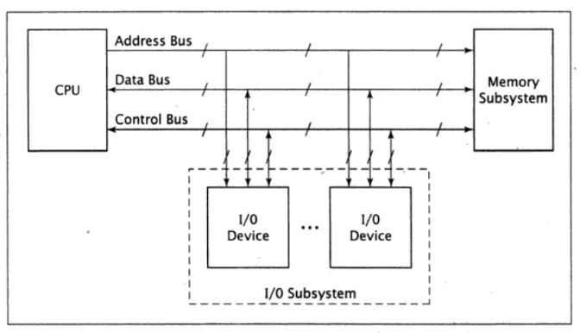
1. Basic Computer Organization
This organization has three main components:
CPU,
memory subsystem, and
IO subsystem

Slide 4
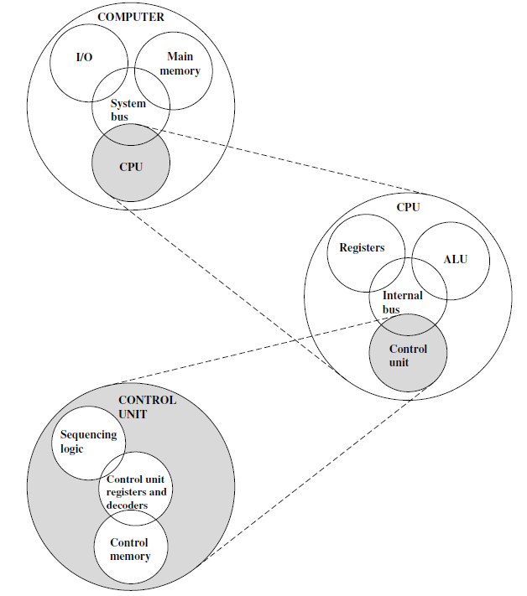
Structural view of Computer System
CPU | Controls the operation of the computer and performs its data processing functions; also referred as processor.
Main Memory | Stores data
I/O | Moves data between the memory and its external environment
System Interconnection | Some mechanism that provides for communication among CPU, main memory and I/O. it is done through system bus.

Slide 5
Structural view of Computer System (Contd.)
Control Unit: | Controls the operation of the CPU and hence the computer.
ALU: | Performs the computer’s data processing function.
Registers: | Provides storage internal to the CPU.
CPU interconnection: | Some mechanisms that provide for communication among the CU, ALU and registers.

Slide 6
Structural view of Computer System (Contd.)
Control Memory: | The registers which store data related to control operation.
Sequential Logic: | Digital circuit whose output depends on current input and state of circuit.
CU register & decoder: | Performs storage and interpretation of the instruction.

Slide 7
2. System Buses
Physically, a bus is a set of wires.
The components of the computer are connected to the buses.
To send information form one component to another, the source component outputs data onto the bus.
The destination component then inputs this data from the bus.
As the complexity of a computer system increases, it becomes more efficient at using buses rather than direct connections between every pair of devices.
Buses use less space on a circuit board and require less power than a large number of direct connections.
They also require fewer pins on the chip or chips that comprise the CPU.

Slide 8
2. System Buses (Contd.)
It is a shared transmission medium. Multiple devices connect to the bus, and a signal transmitted by one device is available for reception by all other devices attached to the bus.
If two devices transmit during the same time period, their signals will overlap and become garbled.
Thus, only one device, at a time, can successfully transmit.
Typically, a bus consists of multiple communication pathways or lines.
Each line is capable of transmitting signals representing binary 1 or 0.
An 8-bit unit of data can be transmitted over eight bus lines.
A bus that connects major computer components (processor, memory, IO) is called a system bus.

Slide 9
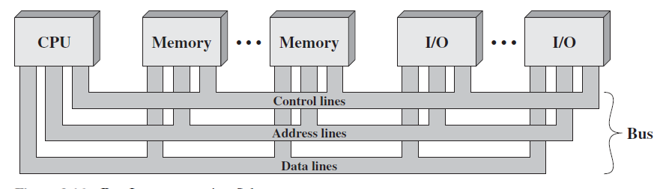
2. System Buses (Contd.)
Data Lines | The data lines provide a path for moving data among system modules. These lines, collectively, are called the data bus.
Address Lines | The address lines are used to designate the source or destination of the data on the data bus.
Control Lines | The control lines are used to control the access to and the use of the data and address lines. Control signals transmit both command and timing information among system modules. Timing signals indicate the validity of data and address information. Command signals specify operation to be performed.

Slide 10
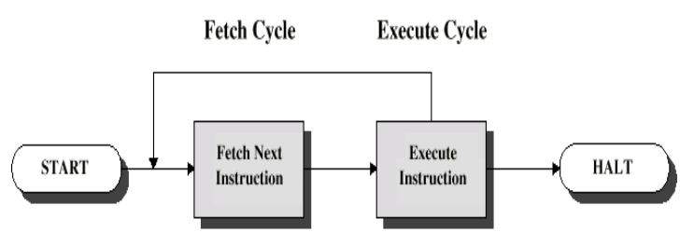
3. Instruction Cycle

Slide 11
3. Instruction Cycle (Contd.)
The instruction cycle is the procedure a microprocessor goes through to process an instruction.
First the microprocessor fetches or reads, the instruction from memory.
Then it decodes the instruction, determining which instruction it has fetched.
Finally, it performs the operations necessary to execute the instruction.
Each of these functions- fetch, decode and execute- consists of a sequence of one or more operations.

Slide 12
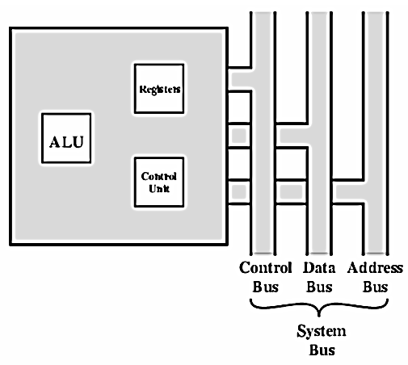
4. CPU organization
CPU consists of three components:
ALU,
CU and
Registers.
ALU performs arithmetic and logical operation,
CU provides control signals, and
Registers store binary information and provide very fast information to ALU and out of CPU.
These components are connected with each other and with external environment through system bus as shown below:

Slide 13
2.4 Memory Sub-system Organization and Interfacing
Memory is the group of circuits used to store data.
Two types of Memory:
RAM
SRAM:
More like registers, no need of refresh
DRAM:
Leaky capacitor, needs refresh
ROM
PROM (Programmable ROM)
EPROM (Erasable PROM)
can be reprogrammed if required by exposing it to ultraviolet light.
EEPROM (Electrically Erasable PROM)
write and erase operations are performed one byte at a time , by application of electrical potential
Flash Memory
Reference: https://www.guru99.com/different-types-ram-random-access-memory.html
https://www.scaler.com/topics/what-is-rom/

Slide 14
RAM Vs ROM
Volatile in nature.
Used for reading and writing data in any order as required.
Data is stored and read many times to and from this type of memory.
Memory cells can be accessed for information transfer from any desired random location.
Read only memory (ROM) contains a permanent pattern of data that cannot be changed.
A ROM is non-volatile, i.e., no power source is required to maintain the bit values in memory.
While it is possible to read a ROM, it is not possible to write new data into it.
The data or program is permanently presented in main memory and never be loaded from a secondary storage device with the advantage of ROM.

Slide 15
Internal Chip Organization
Linear organization
Two-dimensional organization

Slide 16
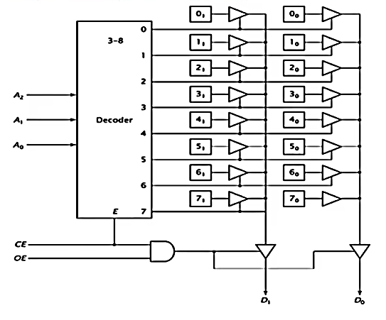
Linear organization
Consider an 8 x 2 ROM chip: (Chip is in 2^{n} x m representation where n is address line and m is data line)
Address line = 3
Data lines = 2
16 bits of internal storage
If CE = 0, decoder is disabled and no location is selected. The Tri-state buffer for that location’s cell are enabled, allowing data to pass to the output buffers.
If CE = 1and OE= 1, tri-state buffer for that location cell is enabled and data is output from the chip; otherwise the outputs are tri-stated.

Slide 17
Classwork:
show the internal linear configuration of a 32x2 memory chip.

Slide 18
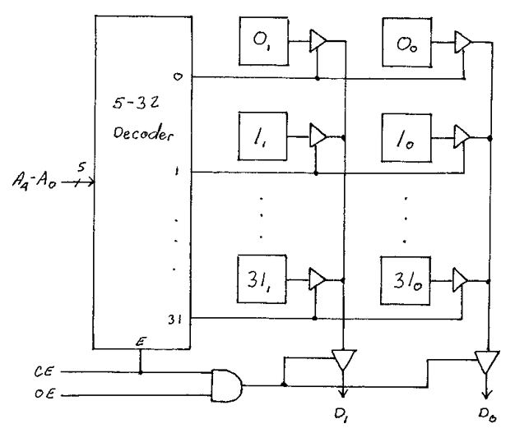
Classwork:
show the internal linear configuration of a 32x2 memory chip.

Slide 19
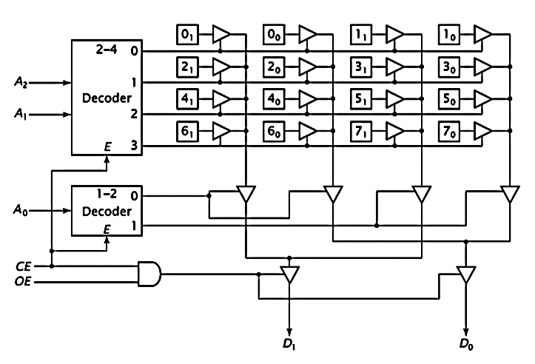
Two-dimensional organization
As the number of locations increases, the size of address decoder needed, becomes extremely large.
To remedy this problem, the memory chip can be designed using multiple dimension of decoding.
This configuration has four rows with four bits per row; each holds two data values.
Here,
A0→ selects one of the 2 locations in a row
A1, A2→ selects one of 4 rows.

Slide 20
2.5 Memory Sub system Configuration
There is technique for joining memory chips to form a memory subsystem.
Two or more chips can be combined to generate a memory with more bits per location.
This is done by linking the corresponding address and control signals of the chips and linking their data pins to various bits of the data bus.

Slide 21
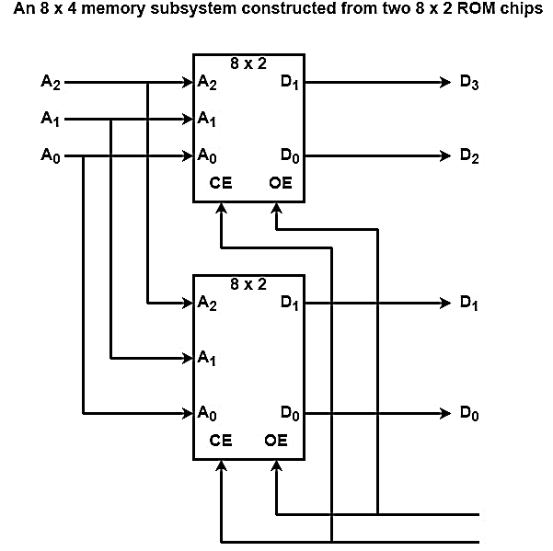
Construction of 8 x 4 ROM from two 8 x 2 ROMs:
Two 8 x 2 chips can be combined to generate an 8 x 4 memory as displayed in the figure.
Both chips get the equal three address inputs from the bus, and the same chip enable (CE) and output enable (OE) signals.

Slide 22
Construction of 8 x 4 ROM from two 8 x 2 ROMs:
The data chips of the first chips are linked to bits 3 and 2 of the data bus(i.e. D₃ and D₂)
and those of the other chips are linked to bits 1 and 0 (i.e. D₁ and D₀)
When the CPU reads data, it locates the address on the address bus.
Both chips read in address bits A₂, A₁, and A₀ and implement their internal decoding..

Slide 23
Construction of 8 x 4 ROM from two 8 x 2 ROMs:
If the CE (Chip Enable) and OE (Output Enable) signals are activated, the chips output their data onto the four bits of the data bus.
Because the address and enable signals are equal for both chips, either both chips and neither chip is active at any given time.
The device never has only one of the two, active.
For this reason, they facilitate as only a single 8 x 4 chip at least until the CPU is concerned.

Slide 24
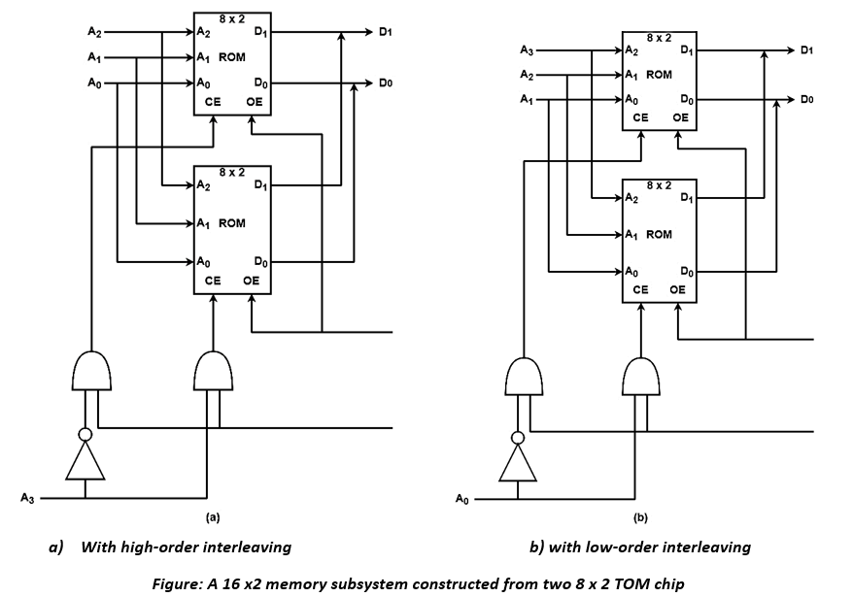
Construction of 16 x 2 ROM from two 8 x2 ROM chip:
Instead of generating wider words, chips can be combined to make more words.
The similar two 8 x 2 chips could alternatively be configured as a 16 x 2 memory subsystem.

Slide 25
Using high-order interleaving
The configuration in figure (a) uses high-order interleaving. All memory locations inside a chip are contiguous within system memory.
The upper chip is configured as memory locations 0 to 7 (0000 to 0111) and
the lower chip as locations 8 to 15 (1000 to 1111).
The upper chip always has A₃=0 and the lower chip has A₃=1.
This difference can choose one of the two chips.
When A₃=0, the upper chip is enabled and the lower chip is disabled.
The output enables can be linked, because only the chip that is enabled with output data.
Both chips correspond to similar data bits, both are linked to D₁ and D₀ of the data bus

Slide 26
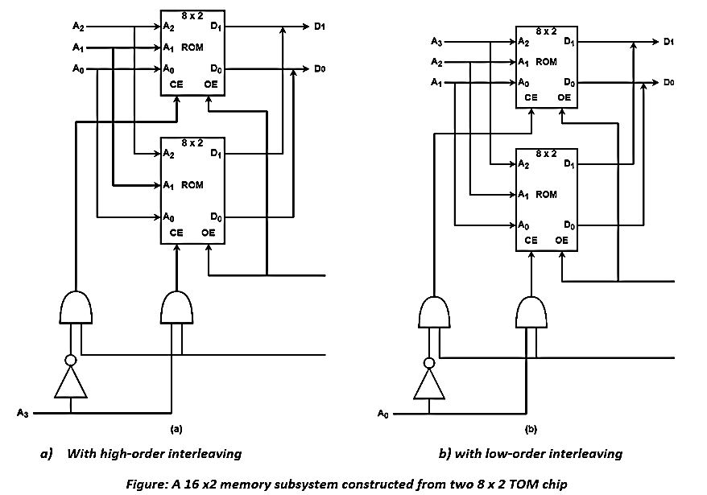
Using low-order interleaving
Consider the configuration displayed in figure (b) which uses low-order interleaving.
The upper chip is enabled when A₀=0, or by addresses XXX0, in this case, 0, 2, 4, 6, 8, 10,12, and 14.
The lower chip is enabled when A₀=1, which is correct for addresses 1, 3, 5, 7, 9, 11, 13, and 15.

Slide 27
Classwork:
1. Design a 16x4 memory subsystem with low order interleaving using 8x2 memory chips for a computer system with an 8-bit address bus.

Slide 28
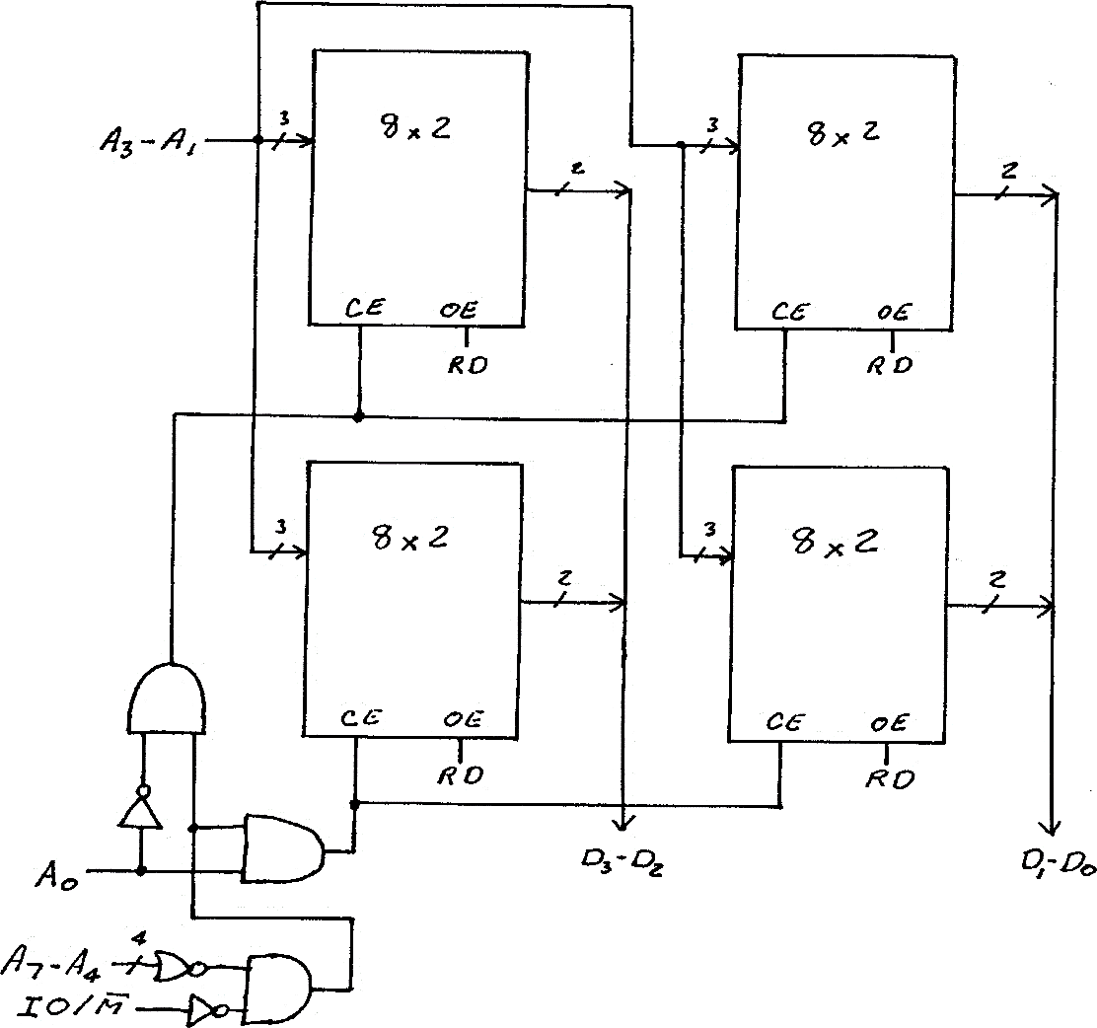
Classwork:
Design a 16x4 memory subsystem with low order interleaving using 8x2 memory chips for a computer system with an 8-bit address bus.

Slide 29
2. Design a 32x 8 memory subsystem with high-order interleaving using 16x2 memory chips for a computer system with an 8-bit address bus.

Slide 30
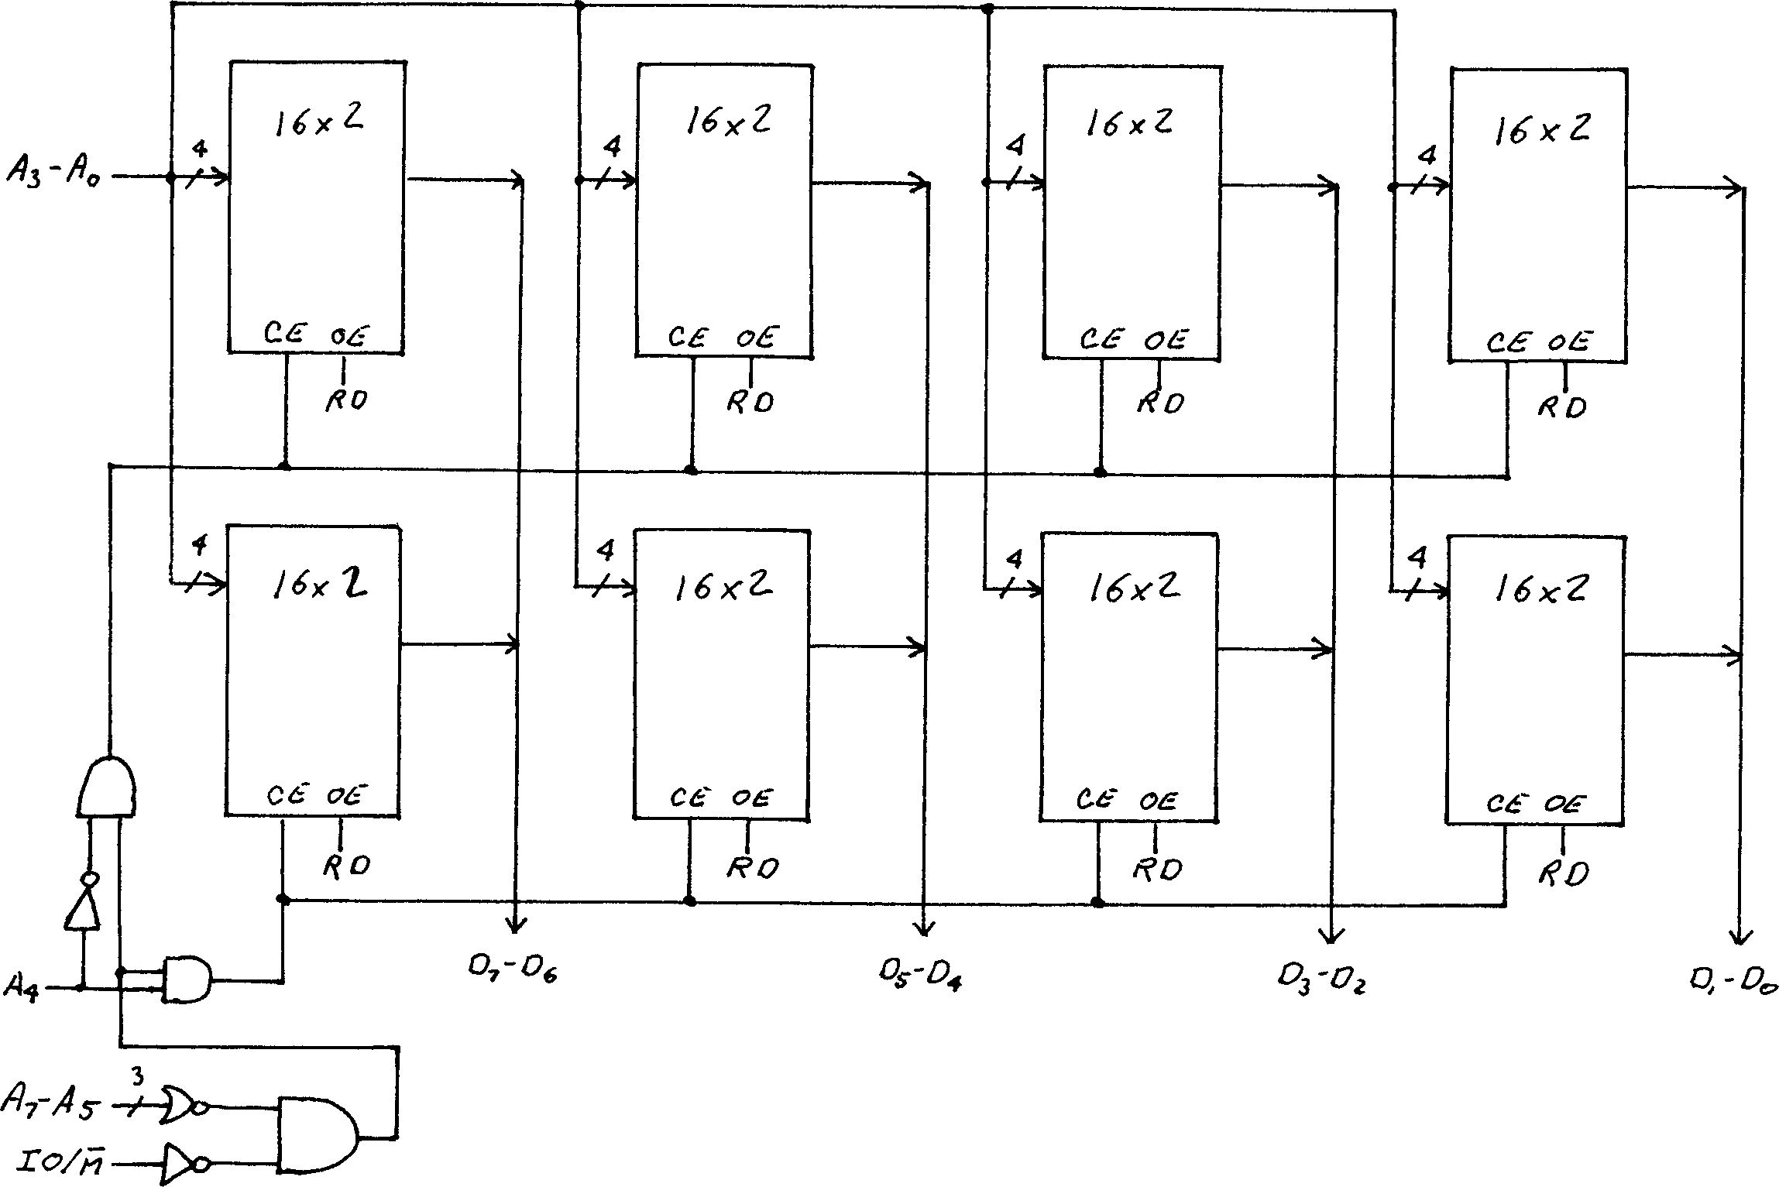
Design a 32x 8 memory subsystem with high-order interleaving using 16x2 memory chips for a computer system with an 8-bit address bus.

Slide 31
3. Design a 32x8 memory subsystem with low order interleaving using 16x2 memory chips for a computer system with an 8-bit address bus.

Slide 32
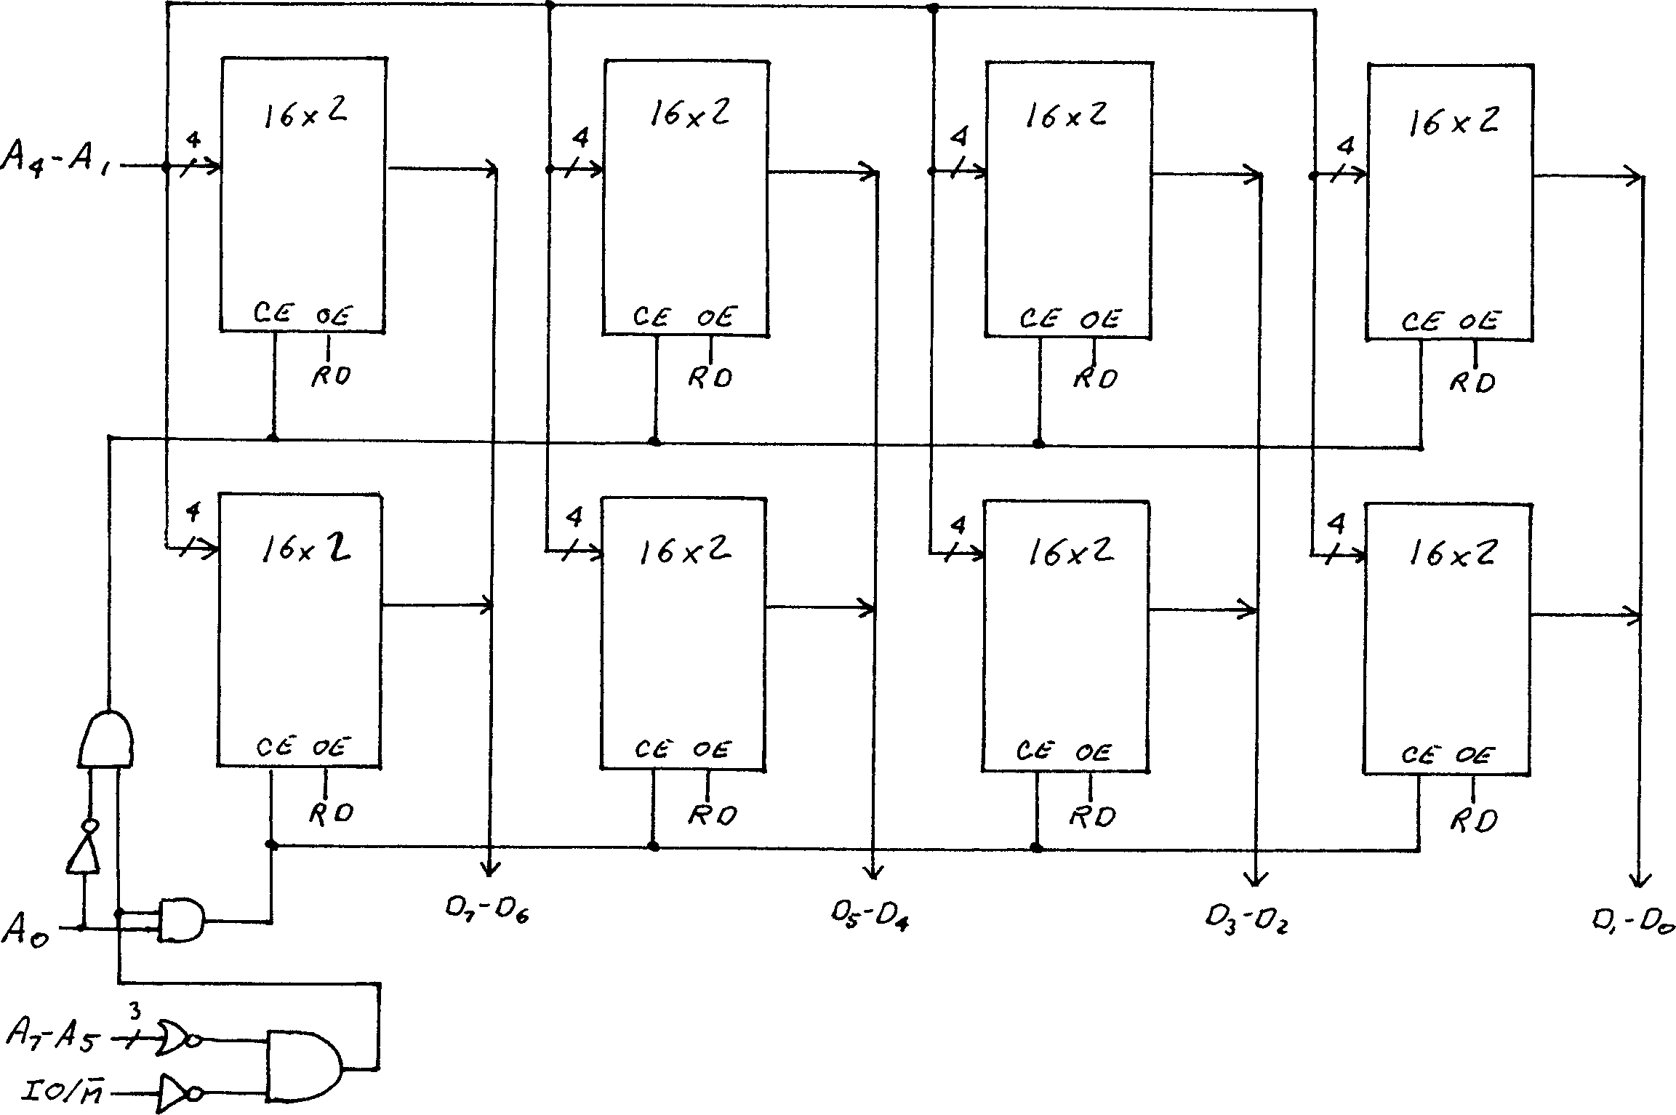

Slide 33

2. Design a 32x8 memory subsystem with low order interleaving using 16x2 memory chips for a computer system with an 8-bit address bus.

Slide 34

6. I/O subsystem Organization and Interfacing
The I/O subsystem is treated as an independent unit in the computer.
The CPU initiates I/O command generally as Read, Write, Scan, etc.
As shown in figure:
The I/O device is connected to the computer system address, data and control buses.
Each I/O device includes I/O circuitry that interacts with the buses.

Slide 35
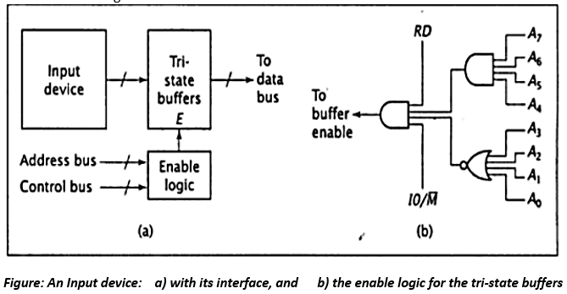
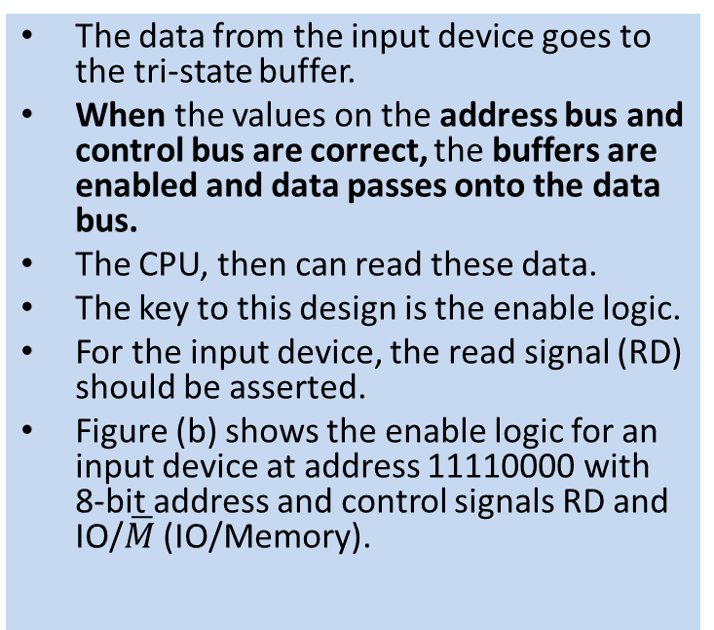
Input device
The data from the input device goes to the tri-state buffer.
When the values on the address bus and control bus are correct, the buffers are enabled and data passes onto the data bus.
The CPU, then can read these data.
The key to this design is the enable logic.
For the input device, the read signal (RD) should be asserted.
Figure (b) shows the enable logic for an input device at address 11110000 with 8-bit address and control signals RD and IO/$\overline{M}$ (IO/Memory).

Slide 36
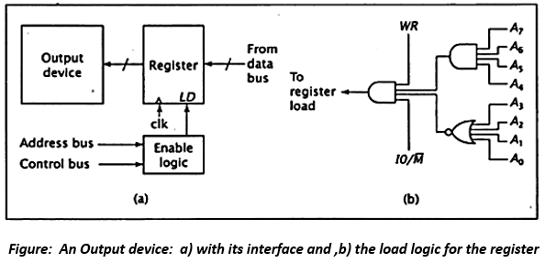
Output Device:
For the interface circuit for an output device, the tri-state buffer is replaced by a register.
Only the device with the correct address will read it in.
The Load logic (LD) plays the role of the enable logic as in the input device.
When this logic receives the correct address and control signals, it asserts the LD signal of the register, causing it to read data from the system’s data bus.
The output device can then read the data from the register at its leisure while the CPU performs other tasks.
The logic to generate the load signal for an output device at address 1111 0000 is shown in figure (b).

Slide 37
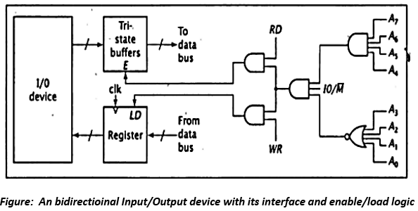
Bidirectional IO device
Some devices are used for both input and output. A personal computer’s hard disk drive falls into this category.
Such a device requires a combined interface that is essentially two interfaces, one for input and the other for output.
Some logic elements, such as the gates that check the address and the address bus, can be used to generate both the buffer enable and register load signals.
Figure below shows a combined I/O interface for address 1111 0000.

Slide 38
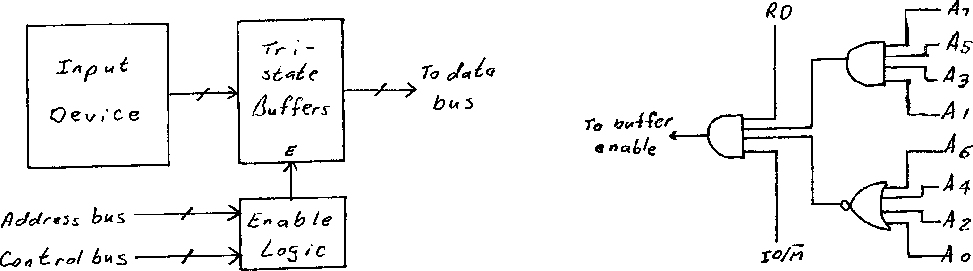
1. Design an interface for an input device which has binary address 1010 1010. Its computer system uses isolated I/0.

Slide 39
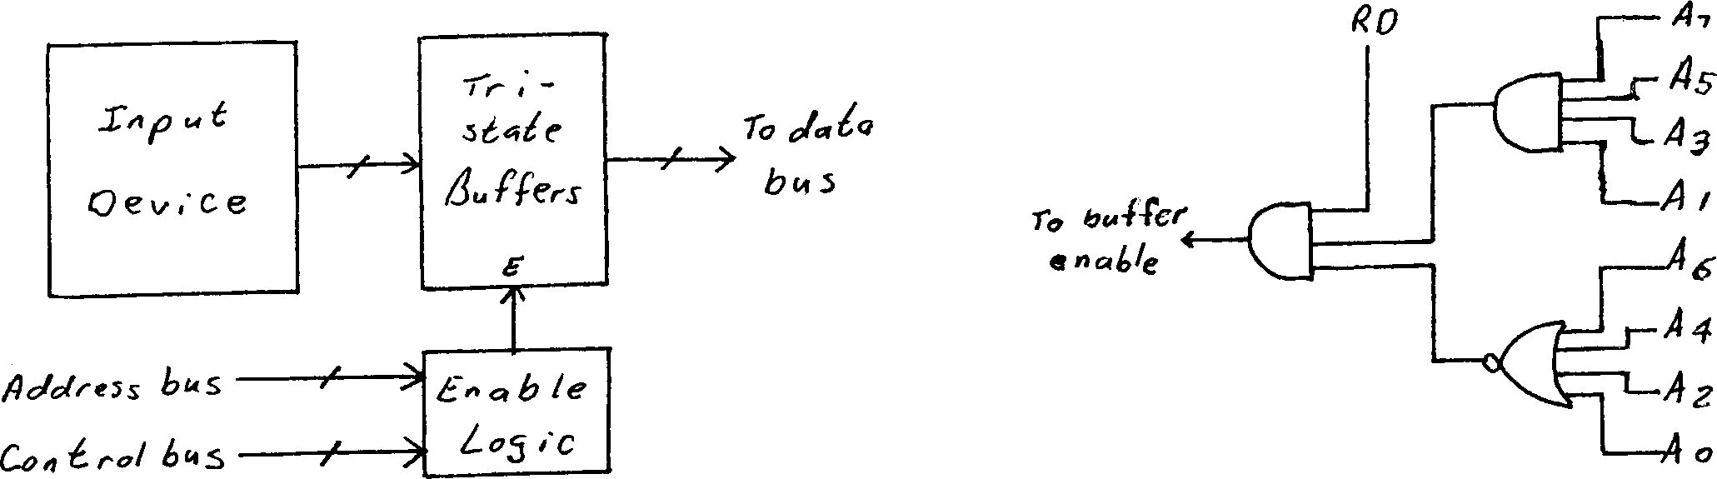
2. Design an interface for an input device which has binary address 1010 1010. Its computer system uses memory mapped I/O.

Slide 40
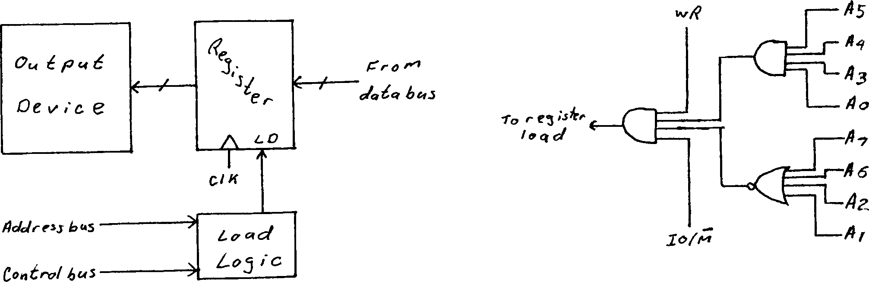
3. Design an interface for an output device which has binary address 0011 1001. Its computer system uses isolate I/O.

Slide 41
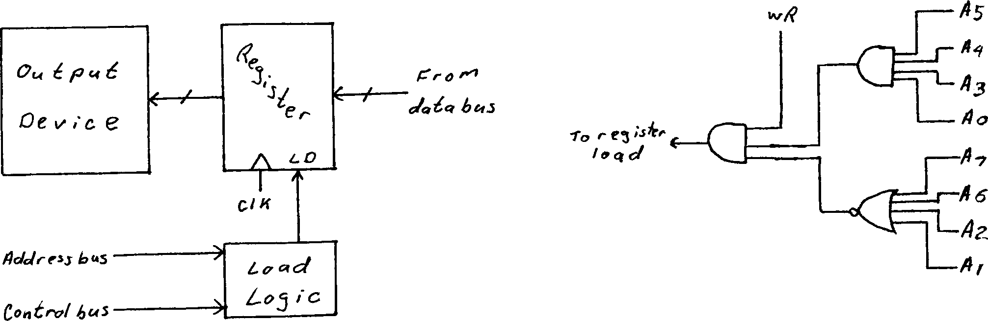
4. Design an interface for an output device which has binary address 0011 1001. Its computer system uses memory mapped I/O.

Slide 42
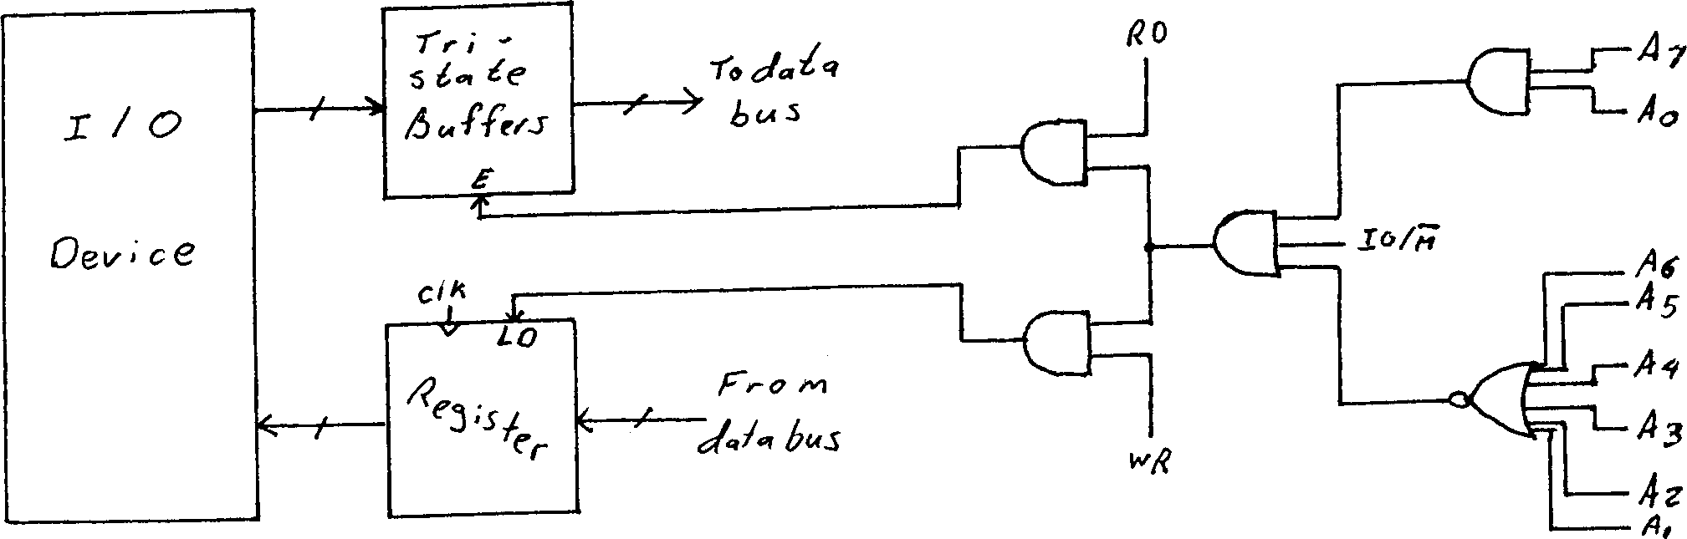
5. Design an interface for a bidirectional Input/output device that has binary address 1000 0001. Its computer system uses Isolated I/O.

Slide 43
6. A CPU with 8-bit data bus and 8-bit address bus uses memory mapped I/O. It has 32 byte of ROM at 00H and 32 byte of ROM at 20H. It also has an I/O device at FFH. Show the load logic and enable logic.

Slide 44
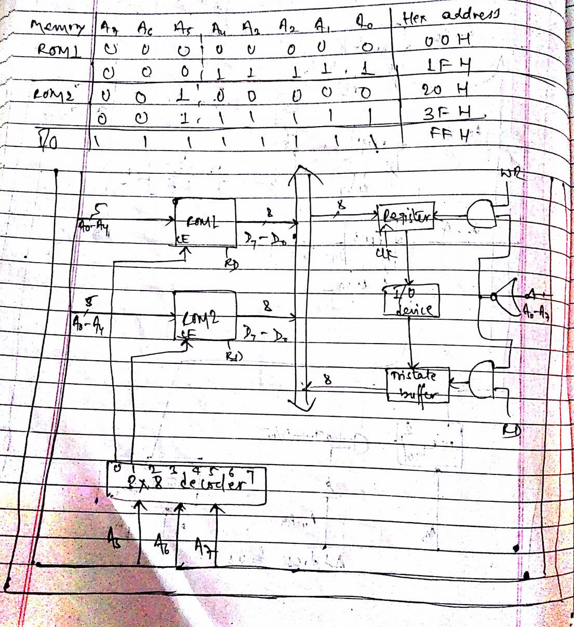
6. A CPU with 8-bit data bus and 8-bit address bus uses memory mapped I/O. It has 32 byte of ROM at 00H and 32 byte of ROM at 20H. It also has an I/O device at FFH. Show the load logic and enable logic.

Slide 45
7. A computer system with an 8-bit address and an 8-bit data bus using isolated I/O. It has 16 x 8 ROM starting at address 00H constructed using 8 x8 chips; 64 x 8 of RAM starting at address 80H constructed using 64 x 4 chips. There is an I/O device at 40H. Show the design for the system.

Slide 46
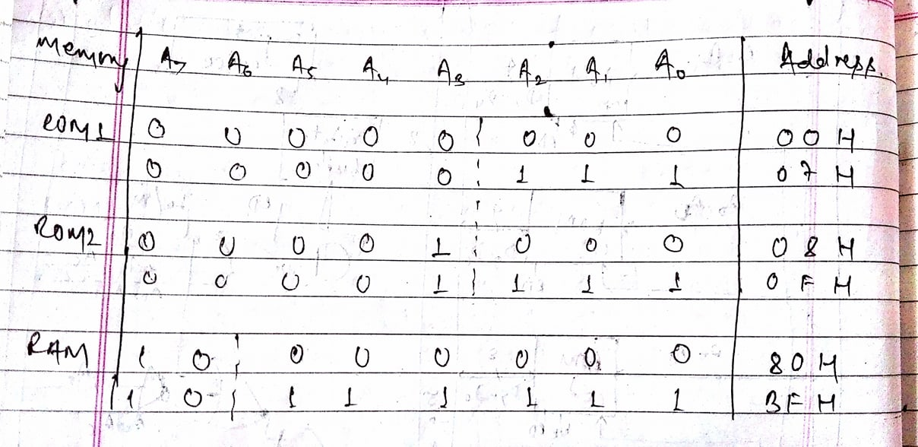
7. A computer system with an 8-bit address and an 8-bit data bus using isolated I/O. It has 16 x 8 ROM starting at address 00H constructed using 8 x8 chips; 64 x 8 of RAM starting at address 80H constructed using 64 x 4 chips. There is an I/O device at 40H. Show the design for the system.

Slide 47
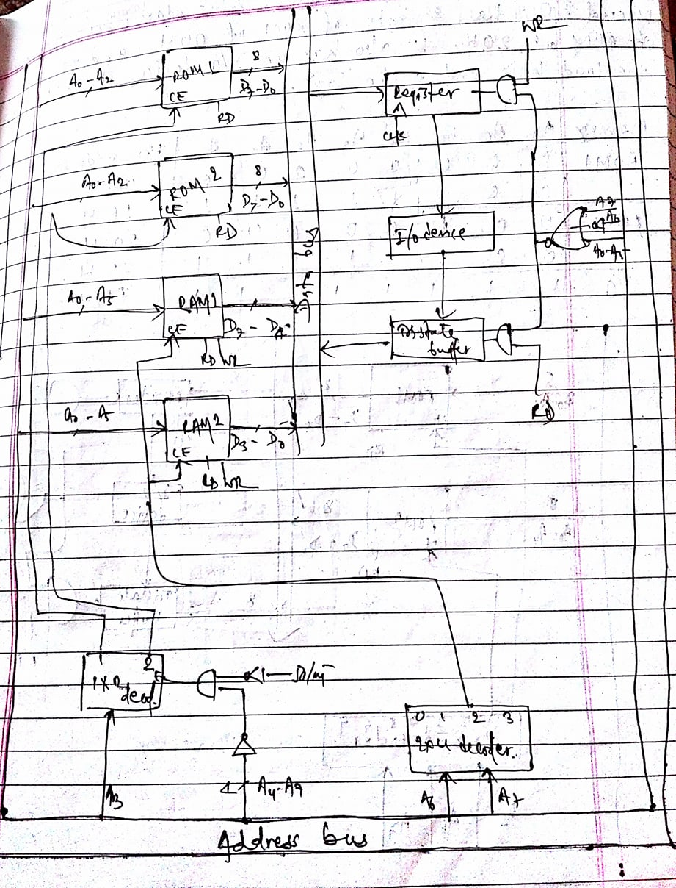

Slide 48
8. A computer system with 8-bit data bus and 8-bit control bus uses isolated I/O. It has 64 bytes of ROM starting at 00H constructed using 64 x 4 chips; 128 bytes of RAM, starting at address 40H constructed using 32 x 8 chips; an input device with READY signal at address 40H; and an output with no READY signal at address 80H. Show the design for this system. Include all enable and load logic.

Slide 49
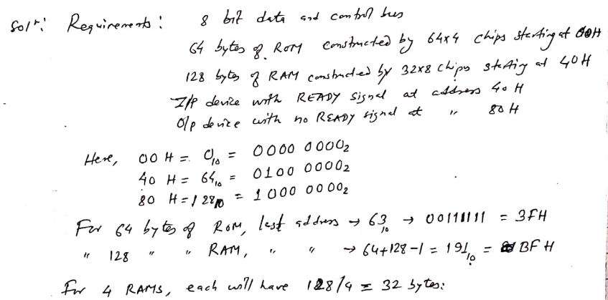
8. A computer system with 8-bit data bus and 8-bit control bus uses isolated I/O. It has 64 bytes of ROM starting at 00H constructed using 64 x 4 chips; 128 bytes of RAM, starting at address 40H constructed using 32 x 8 chips; an input device with READY signal at address 40H; and an output with no READY signal at address 80H. Show the design for this system. Include all enable and load logic.

Slide 50
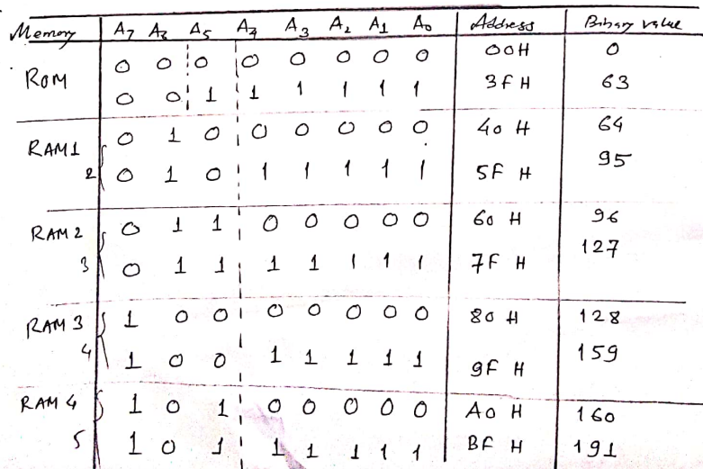
A computer system with 8-bit data bus and 8-bit control bus uses isolated I/O. It has 64 bytes of ROM starting at 00H constructed using 64 x 4 chips; 128 bytes of RAM, starting at address 40H constructed using 32 x 8 chips; an input device with READY signal at address 40H; and an output with no READY signal at address 80H. Show the design for this system. Include all enable and load logic.
Decimal Value

Slide 51
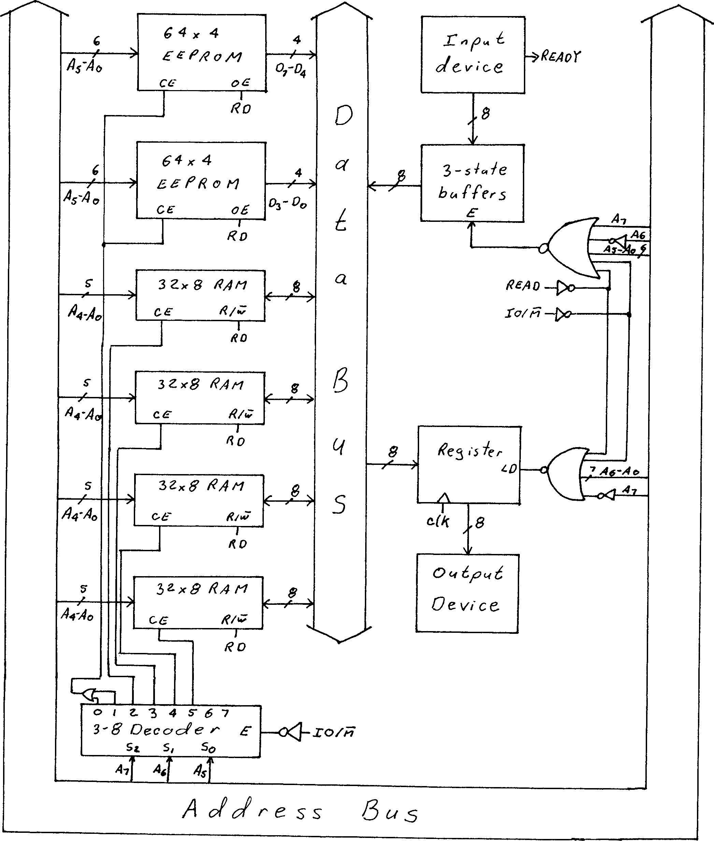
40H=
0100 0000
80H=
1000 0000

Slide 52
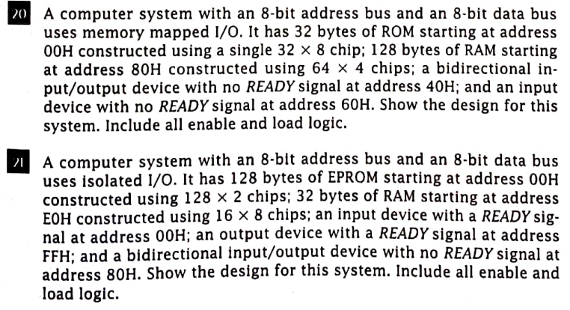
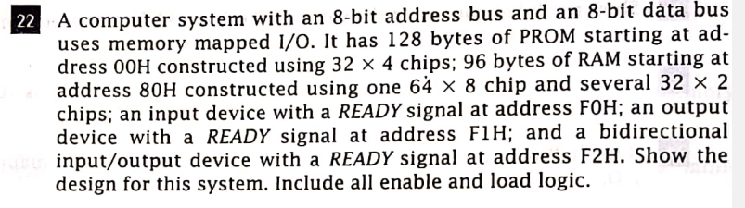

Slide 53
Assignment:
Differentiate between Internal Linear and Two-dimensional Memory Organization.
Explain instruction cycle for read and write operations using their timing diagram.
A computer has a CPU with 8 bit data bus and 8 bit address bus. The system operates in isolated I/O mode. It has a 64 byte ROM at 00H constructed using two 32-byte ROM. It also has a RAM of 128 byte constructed using two 128*4 RAM chips and is integrated with starting address 80H. The system also has an I/O device at 7EH. Show the design for this system including all the required logic.
A computer system with 8 bit address bus and an 8 bit data bus uses isolated IO. It has 64 bytes of EEPROM starting at address 00H constructed using 64x4 chips; 128 bytes of RAM starting at address 40H constructed using 32x8 chips; an input device with a READY signal at address 40H; and an output device with no READY signal at address 80H. Show the design for this system.
A computer has a CPU with 8 bit data bus and 16 bit address bus. The computer uses memory mapped I/O. it has 8K of ROM starting at address 0000H, followed by 8K of RAM. It also has a bidirectional I/O port at address 8000H. Show the design for the system including all the required logic.
Design a 16x8 ROM using 16x4 ROM chips. Illustrate it with both high –order and low order bit interleaving.
Design a 16x8 ROM using 4x8 ROM chips. Illustrate it with both high –order and low order bit interleaving.
Design a 16x8 ROM using 4x4 ROM chips. Illustrate it with both high –order and low order bit interleaving.

Slide 54
Exam questions:
A computer has a CPU with 8-bit address bus and 16-bit data bus. The computer uses isolated I/O. It has 64 bytes of ROM at 10 H; constructed using two 32 bytes ROM chips. It also has 32 bytes of RAM at C0 H. The system has an I/O device at 85 H. Show the design for the system including all the required logic. [ 2017 Fall]
A computer has a CPU with 8-bit address bus and 8-bit data bus. The computer uses Memory mapped I/O. It has 32 bytes of ROM at 10 H; constructed using two 16 bytes ROM chips. It also has 32 bytes of RAM at 80 H. The system has an input device at F7 H and an output device at F8 H. Show the design for the system including all the required logic. [ 2017 spring]
A computer has a CPU with 8-bit address bus and 16-bit data bus. The computer uses Isolated I/O. It has 64 x 16 of ROM at 00 H; constructed using two 32 x 16 ROM chips. It also has 32 x16 of RAM at C0 H. The system has an input device at 17 H and an output device at B5 H. Show the design for the system including all the required logic. [PU 2018 Fall]
Design an 8x4 ROM chips using 4x4 ROM chips. Illustrate using lower order interleaving. [PU 2018 Spring]
Define enable and load logic. Generate load logic for an output device at CFh. Assume the system being operated in isolated mode. [PU 2018 Spring]
Design a 32 B RAM using four 16x4 ROM chips. [PU 2019 Spring]
Design 16x4 memory sub-system constructed from 16x2 ROM chips with both low-level and high-level interleaving. [PU 2020 Spring]

Slide 55
End of chapter

